Slide 1
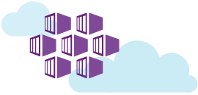

Azure Container Service
Sunny Sharma

Slide 2
Containers
Lightweight alternative to virtual machines
Smaller, less expensive, faster to start up, and self-contained
Virtual Machines
App
App
App
Libraries
Libraries
Libraries
Containers
Guest OS
Guest OS
Guest OS
App
App
App
Libraries
Libraries
Libraries
Hypervisor
Container Engine
Host Operating System
Operating System

Slide 3

Docker
Leading open-source containerization platform
Supported natively in Azure
Docker containers wrap up a piece of software in a complete filesystem that contains everything it needs to run: code, runtime, system tools, system libraries – anything you can install on a server. This guarantees that it will always run the same, regardless of the environment it is running in

Slide 4
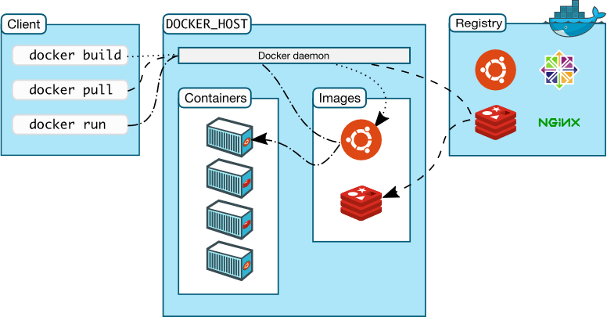
Docker Architecture

Slide 5
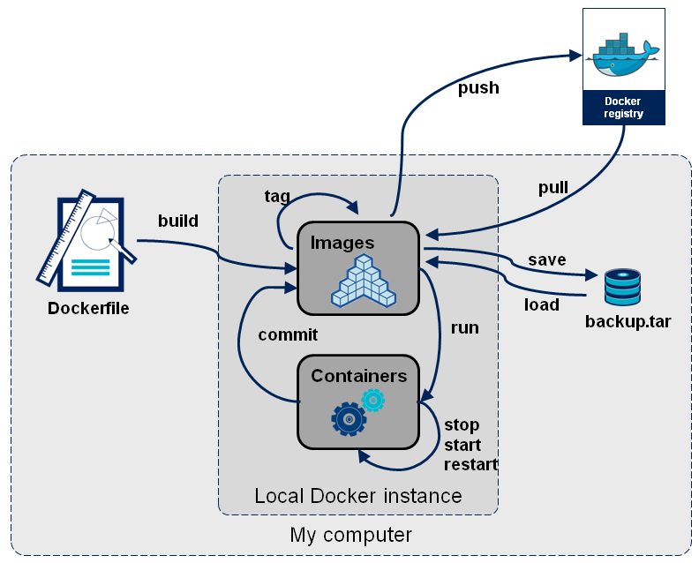
Docker Architecture

Slide 6
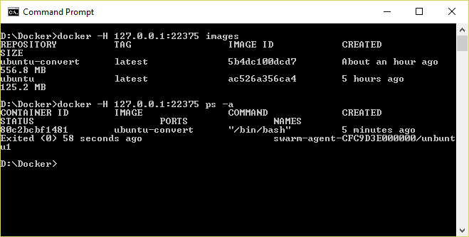
Docker CLI
Command-line interface for Docker, available for Linux, OS X, and Windows (available separately or as part of Docker Toolbox)

Slide 7
Running a Container
docker run -i -t ubuntu /bin/bash
Docker CLI command
Run container with interactive terminal
Pull "ubuntu" image from Docker Hub or local registry
Command to execute in the container

Slide 8
Common Docker CLI Commands
docker run - Use an image to run a container
docker pull - Pull an image from a registry
docker build - Build a Docker image
docker images - List available Docker images
docker ps - List running Docker containers
docker exec - Execute a command in a container
docker stop - Stop a running container

Slide 9
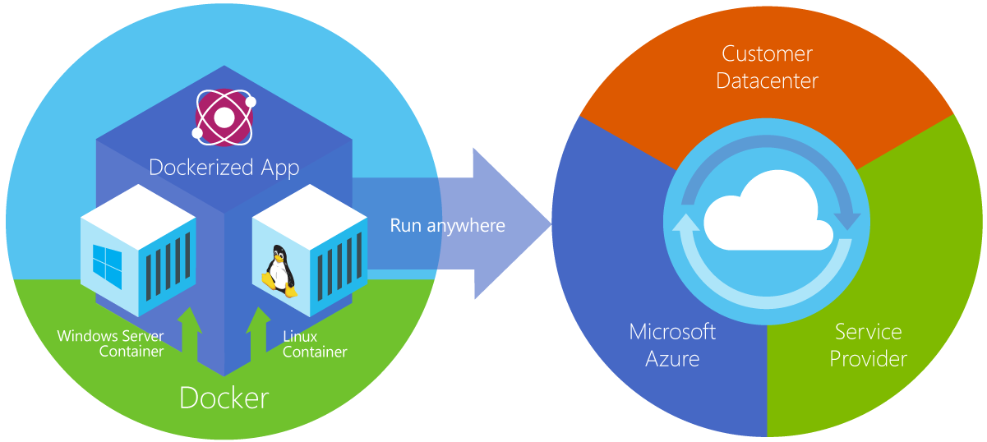
Azure Container Service
Provides robust, ready-to-use Docker hosting environment
Uses open-source orchestration tools (DC/OS and Swarm)

Slide 10
Container Orchestration
Facilitates deployment and management of containers
Containers by design are intended to be deployed in large volumes with some applications using dozens to even thousands of containers
With this type of scale, automating container deployment and management with orchestration software becomes necessary
Azure Container service supports Kubernetes, DC/OS, and Docker Swarm

Slide 11
Container Clusters
Facilitate load balancing, scalability, and high availability
A cluster is composed of master nodes which control the orchestration, and agent nodes that host the containers

Slide 12

Kubernetes
Open-source orchestration engine from Google
Provides a robust framework for container orchestration, yet remains lightweight and scalable
Supported by Azure Container Service and tightly integrated with ACS, allowing Kubernetes to modify deployments

Slide 13
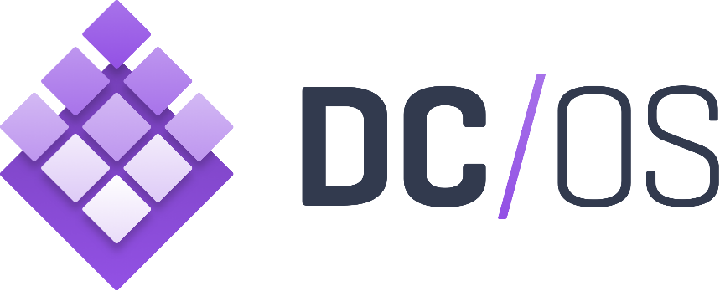
DC/OS
Datacenter Operating System built on Apache Mesos
Creates logical data centers and abstracts underlying hardware
Provides resources traditionally provided by infrastructure, including networking, DNS, and load balancing
Natively supported by Azure Container Service

Slide 14
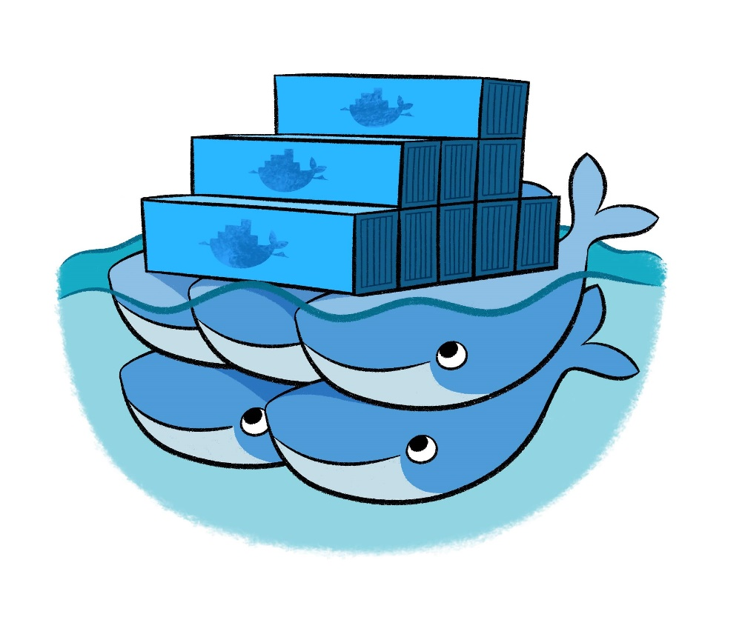
Docker Swarm
Docker’s own orchestration engine
Current releases of the Docker engine have “Swarm Mode” built in and can many of the same things that other orchestration engines do
Lacks a GUI, but makes up for it with tight integration with Docker
Natively supported by Azure Container Service

Slide 15
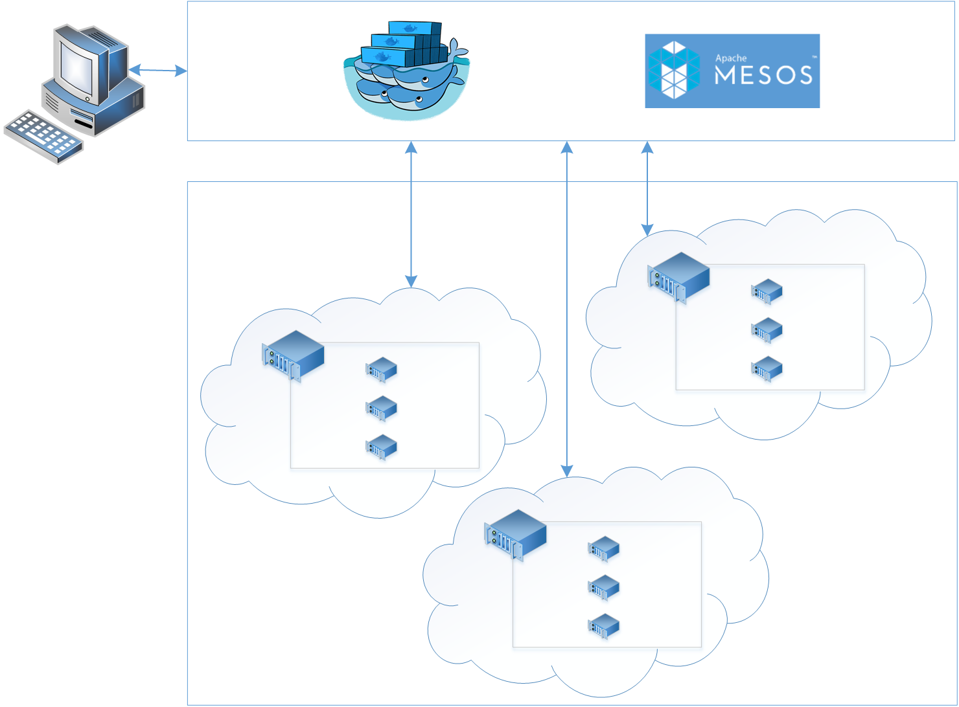

Azure Container Services
App1
App2

Slide 16
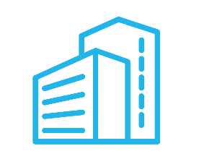

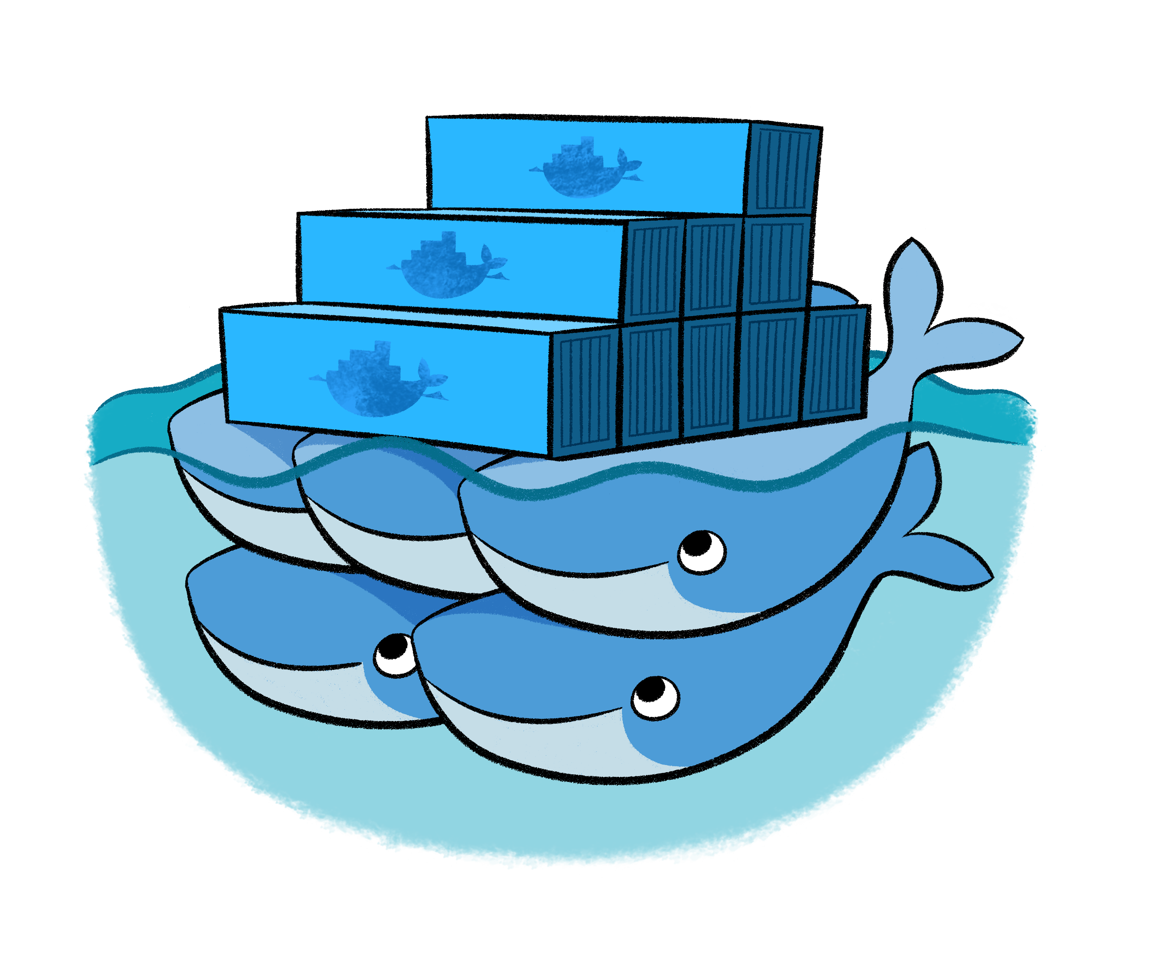
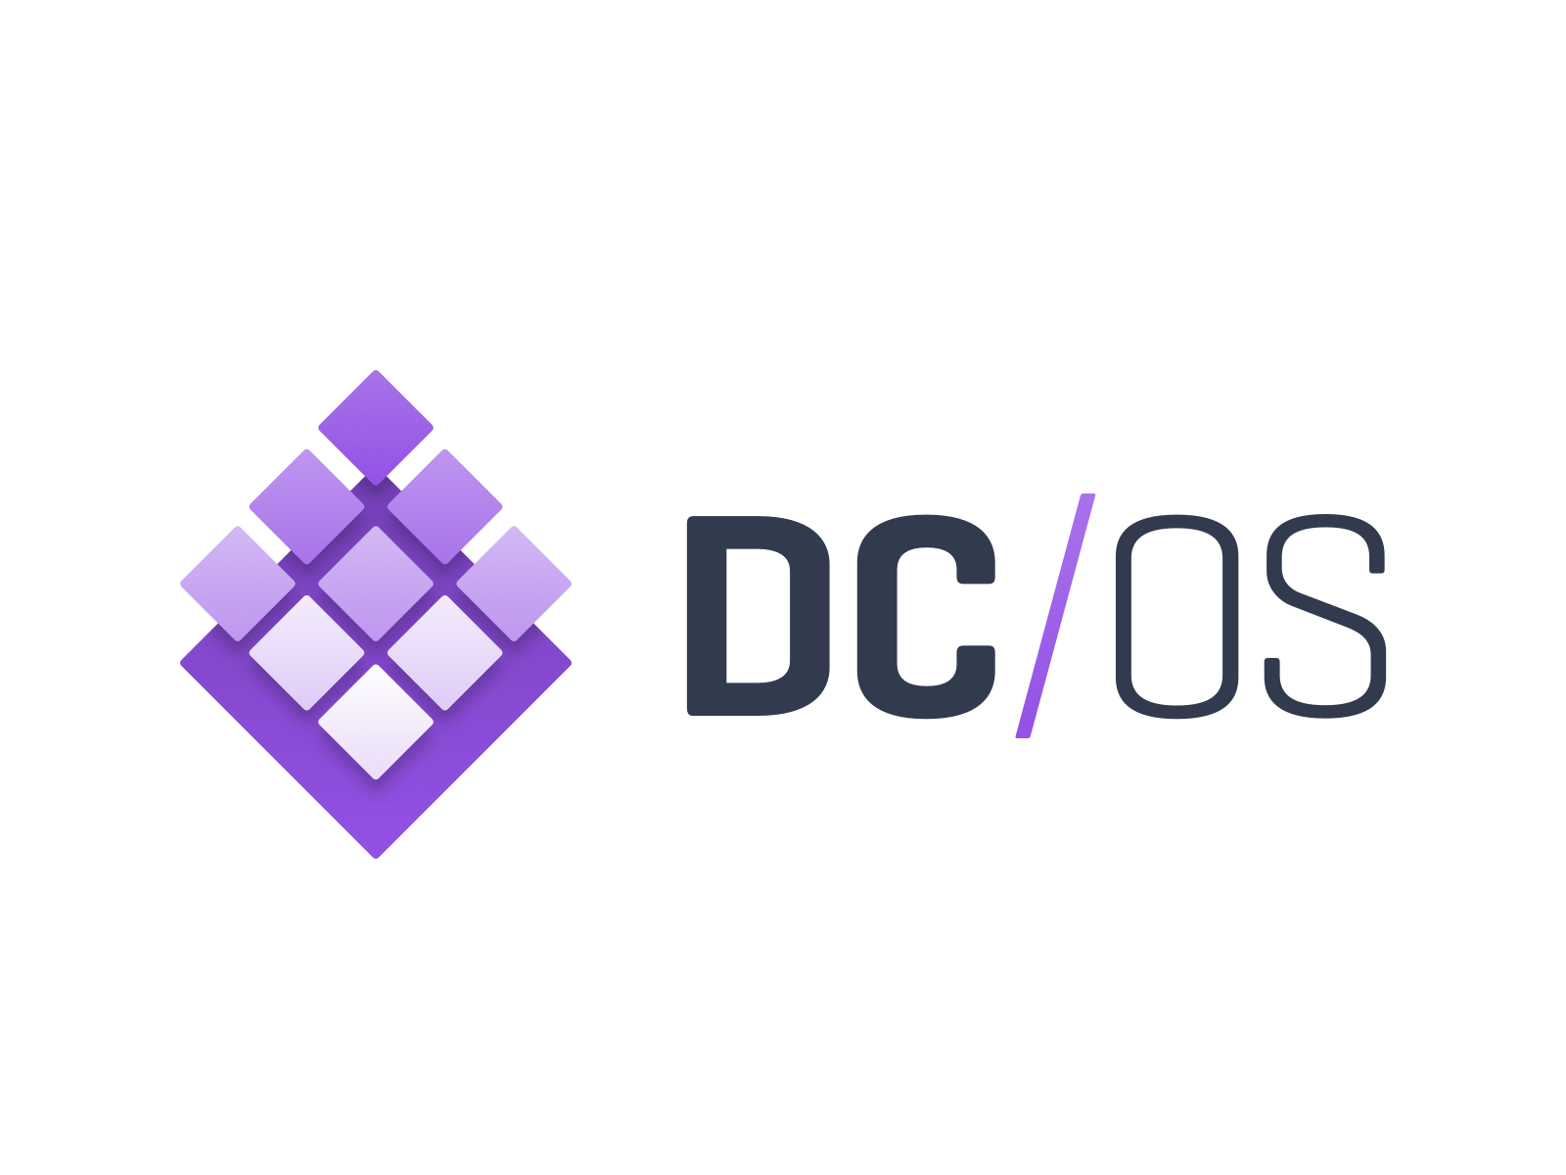
Azure Container Service
Application
Orchestrator
ARM
Template
Infrastructure

Slide 17
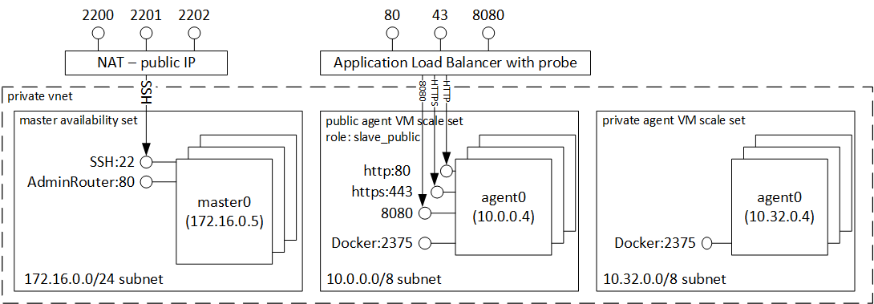
Azure Container Service

Slide 18
Where is the service boundary?
Order Processing
Finance
Shelf
ForkLift
StockItem
StockItem
StockReport
Company Valuation
Picker
PickingOrder
General Ledger

Slide 19
Building Microservices, Sam Newman, O’Reilly Media
Loose Coupling
A change in one service does not require a change in another
High Cohesion
Related behavior sits together, unrelated behavior sits separately
Building Microservices, Sam Newman, O’Reilly Media

Slide 20
Bounded Contexts?
Order processing
Finance
Shelf
ForkLift
StockItem
StockItem
StockReport
Company Valuation
Picker
PickingOrder
General Ledger

Slide 21
Bounded Contexts?
Order processing
Finance
Shelf
ForkLift
StockItem
StockItem
StockReport
Company Valuation
Picker
PickingOrder
General Ledger

Slide 22
Things?
Order Processing
Finance
Shelf
ForkLift
StockItem
StockItem
StockReport
Company Valuation
Picker
PickingOrder
General Ledger

Slide 23

Further Learning References:
https://training.play-with-docker.com
https://labs.play-with-docker.com
https://docs.microsoft.com/en-us/azure/container-service/kubernetes
https://microsoft.github.io/PartsUnlimitedMRPmicro/hols/deploy-acs-kubernetes-helm.html

